Slide 1


Carbon Abatement and Climate Change
The Why’s, the When’s and the How’s

Slide 2
Who are we and why are we here?

Slide 3

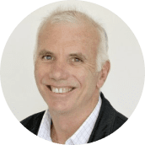





Our founder and CEO, with a vision
Bruce Easton
CEO and Director
Since 2007 Bruce has been a visionary focused on helping Businesses, Industry and households reduce energy use and therefore contribute to the fight against climate change through the reduction of emissions
Through Bruce's guidance and vision Ecovantage has become an Australia wide solutions provider and trusted advisor on energy efficiency.
Our CEO, Bruce Easton, is a key influencer in the energy efficiency sector, having contributed to numerous energy efficiency scheme changes and other working groups. Bruce is a board member of the Energy Efficiency Council and former president of the Energy Efficiency Certificate Creators Association.
Proud members of:

Slide 4




















We keep Good Company.

Slide 5
Cont….
We have no political involvement or motives
We are here for one reason only,
and that is to abate carbon every way we can
We only deal with facts
We don’t create problems, but we deal in solutions every day
You cant talk about Carbon Abatement without talking about Climate Change!

Slide 6
Agenda
What you should take away
The lens we should think through
Where we started
How human activities are causing climate change
What needs to be done re Carbon
When we need to take action
What action we can all take

Slide 7
Setting the Scene

Slide 8
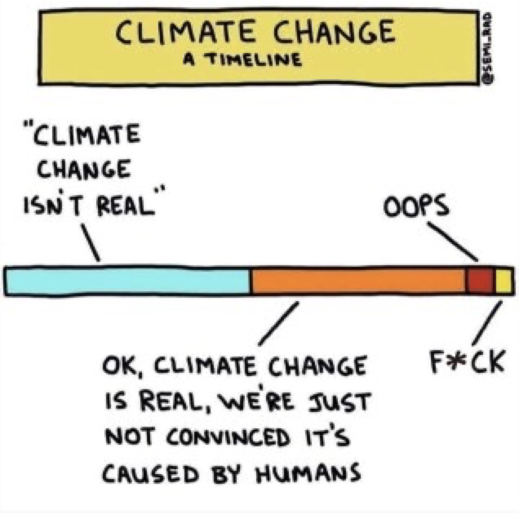
The climate is changing

Slide 9

The lens we must think through
Sustainability
Notes:
“Sustainability is the ability to meet the needs of the present without compromising the ability of future generations to meet their own needs.”

Slide 10
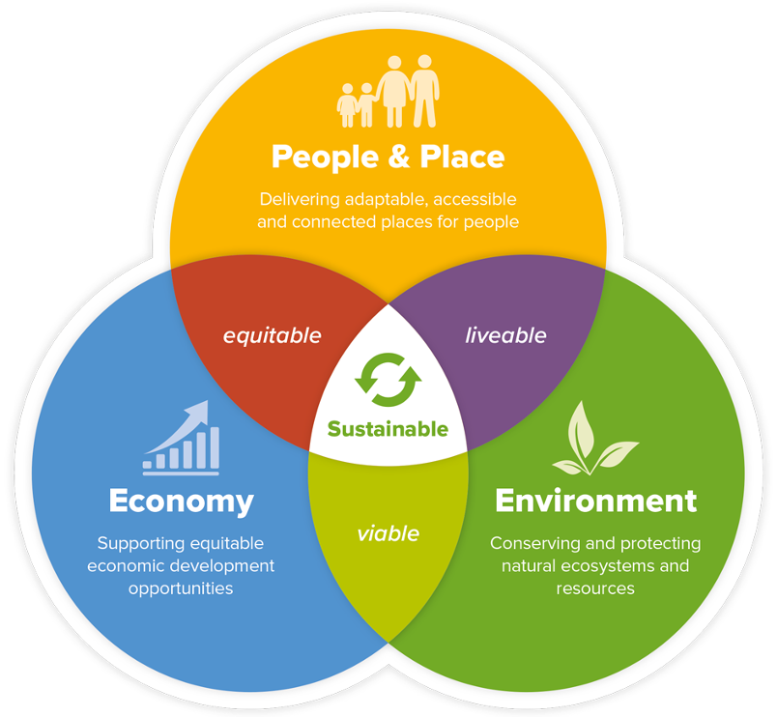
Sustainability

Slide 11
The Why’s

Slide 12
Why should we do anything?
We all have our own why’s, our own reasons on why this should matter
No matter what our beliefs or views are,
let’s look at what we know to be true

Slide 13
Where we started

Slide 14
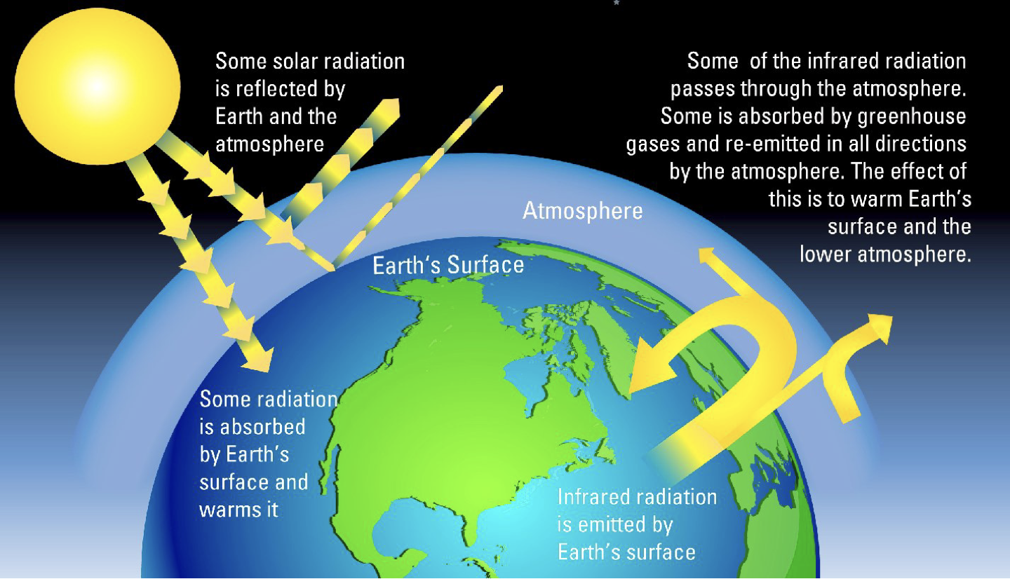
Sustainability

Slide 15
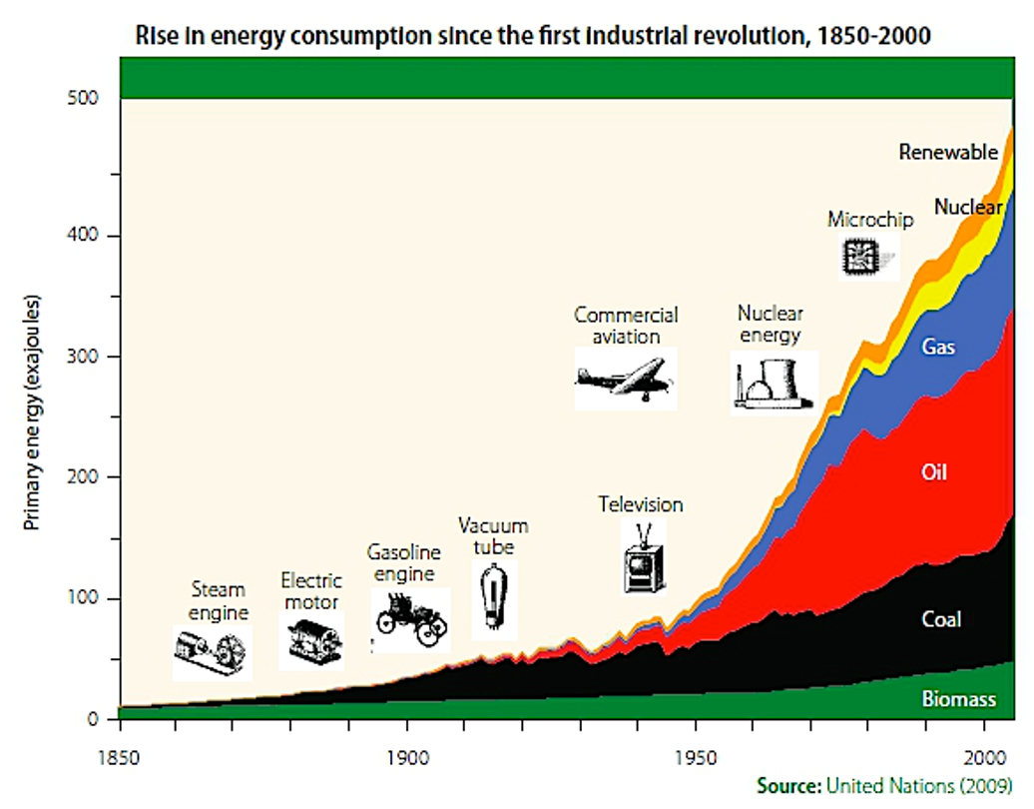
Sustainability

Slide 16
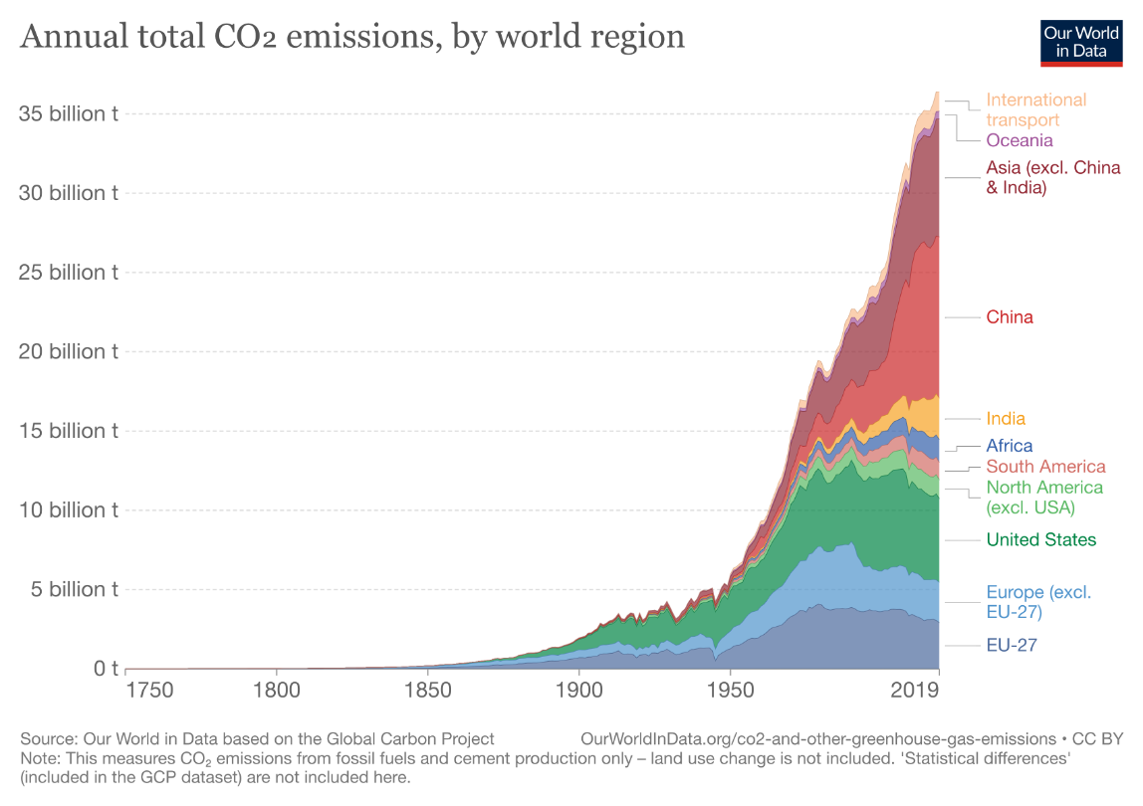
Sustainability

Slide 17
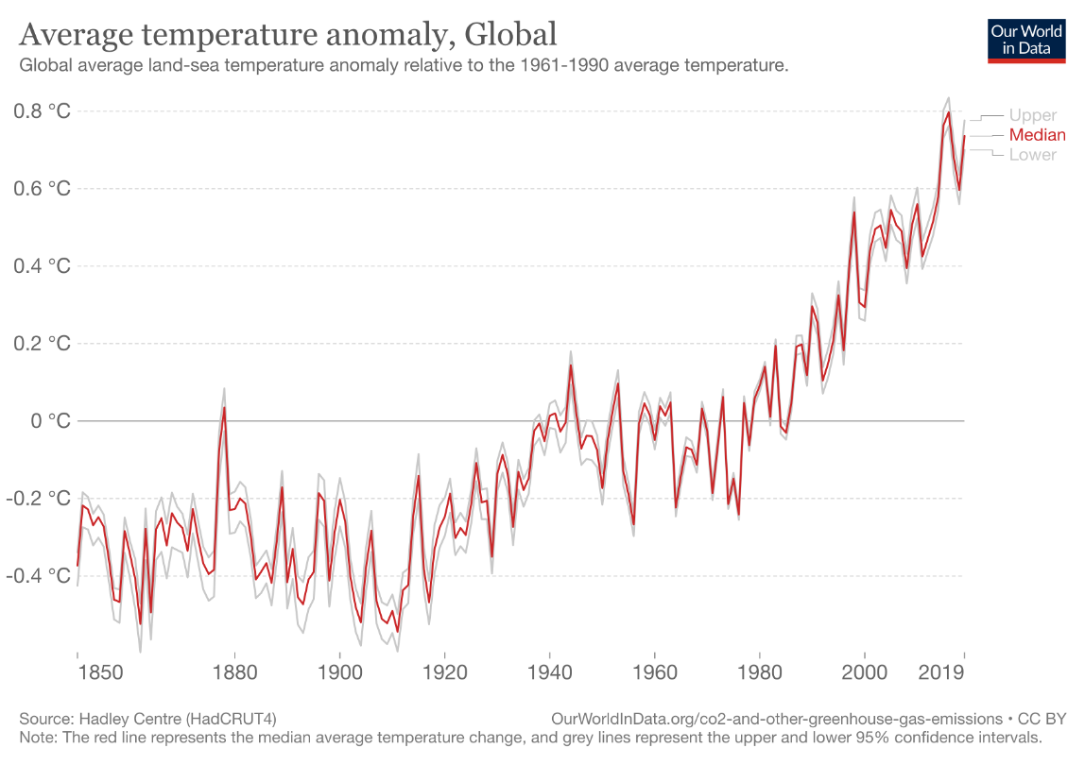
Sustainability
Notes:
A temperature anomaly is the departure from the average temperature, positive or negative, over a certain period (day, week, month or year). In standard usage, the normal average temperature would be calculated over a period of at least 30 years over an homogeneous geographic region.

Slide 18
Where we are now

Slide 19
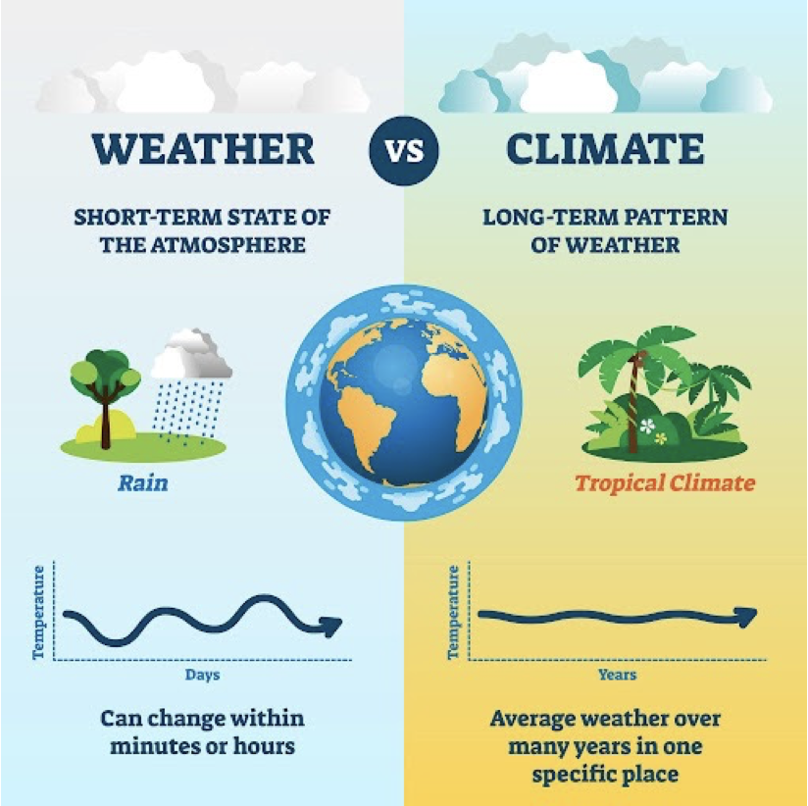
The Climate is Changing

Slide 20
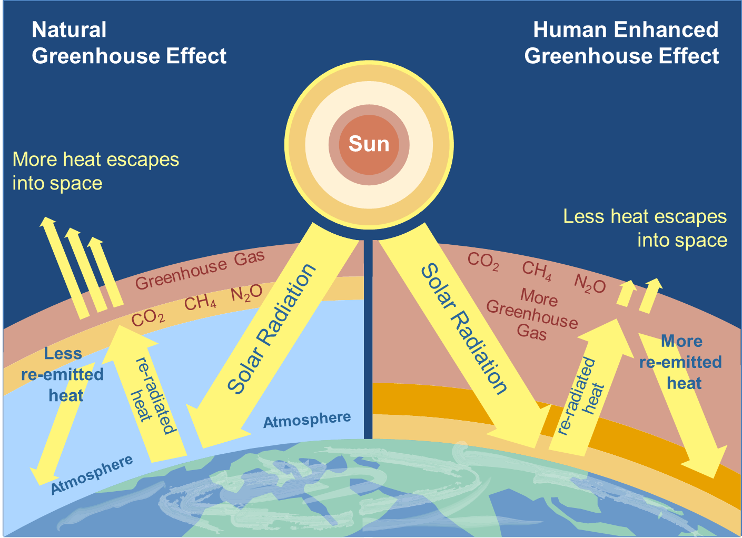

Slide 21
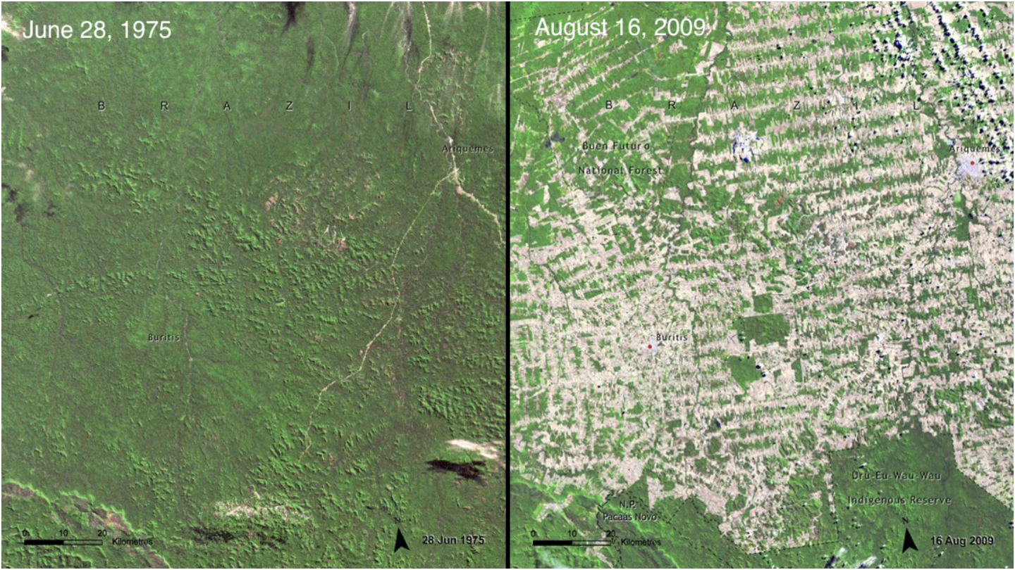

Slide 22
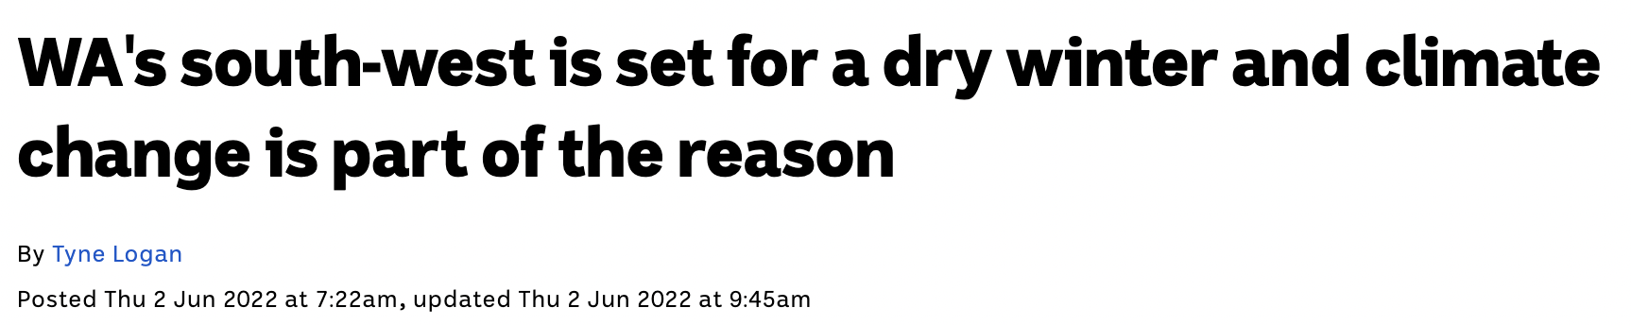
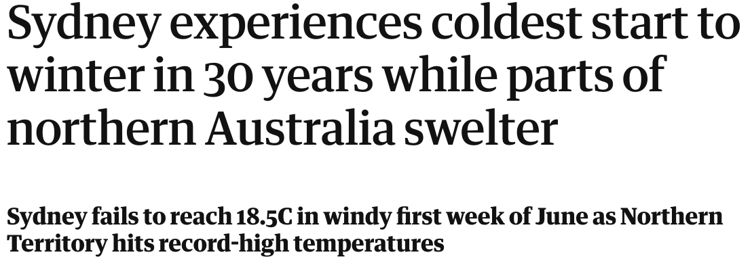
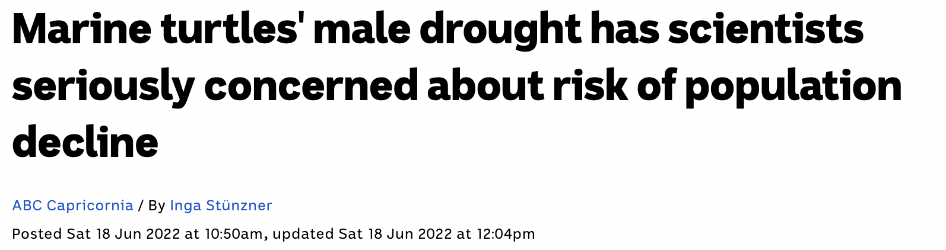
The Climate is Changing

Slide 23
Gympie
I couldn’t bring myself to put anything here
You all live it year in year out

Slide 24
So what is this telling us?
So the evidence suggests the culprit is
CARBON
Whether exclusive or not, it doesn’t matter. It is clear we need to reduce or eradicate Carbon

Slide 25
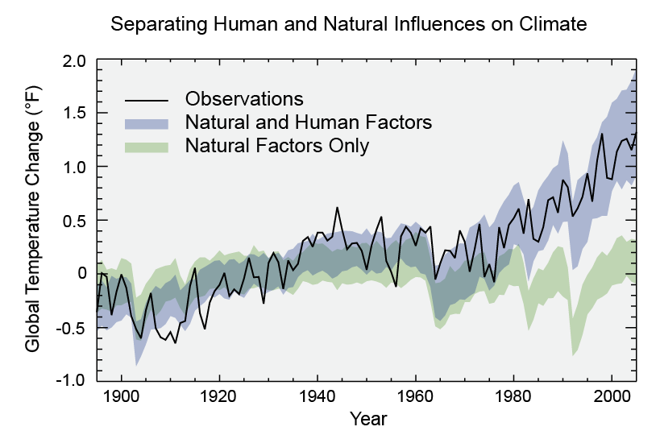

Slide 26
The whens

Slide 27
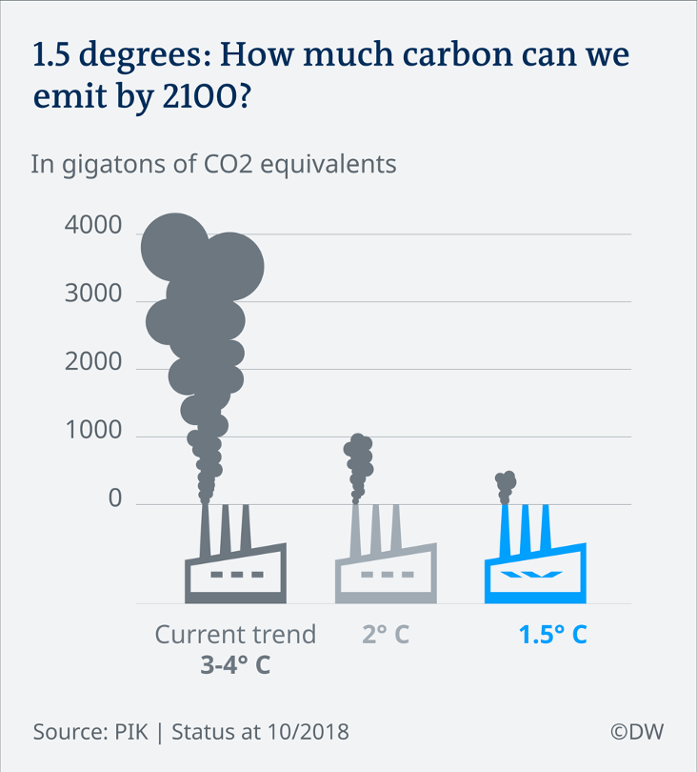
Net zero by 2050

Slide 28
Is this really a question then?
I would hope that it is now clear.
We must start NOW.
Not next year.
Not the next generation.
NOW!

Slide 29
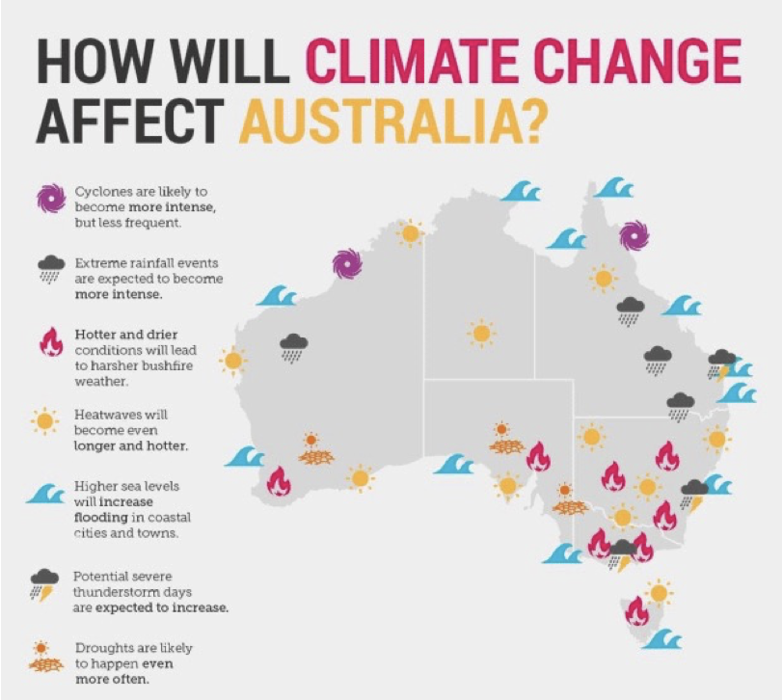
Net zero by 2050

Slide 30
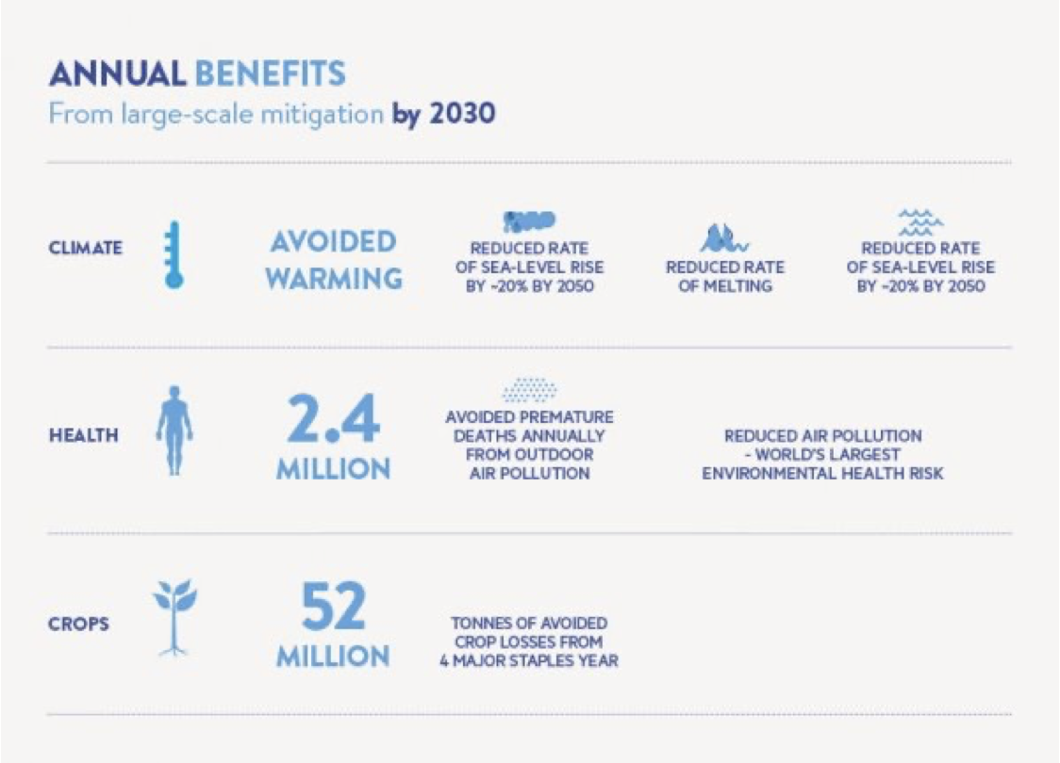

Slide 31
So who's responsible to fix this? governments?

Slide 32
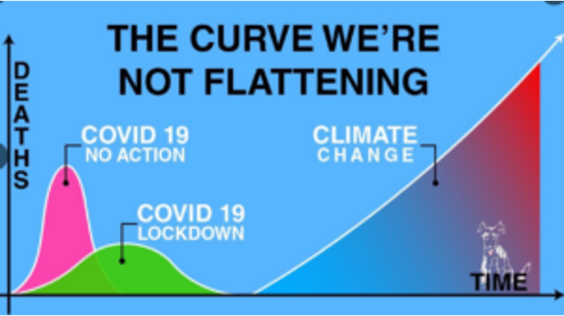
Climate Curve

Slide 33
Our world
If we are going to change this.
If we are going to change the future of the world
OUR WORLD
We must all do our bit.
The Governments may set the targets, but they can’t achieve it without us.
Just a simple FACT

Slide 34
The Hows

Slide 35
The most common statement………
“I know there are targets for carbon Net Zero
But I have no clue what I have to do,
and I have no clue where to start or who to talk to.”

Slide 36
So how do we do our bit
You must start at the start (duhh)
How do you know what to abate unless you know what your carbon footprint is?
Accept your role and responsibility
Understand the scopes of carbon Abatement
Plan, commit, action, review.

Slide 37
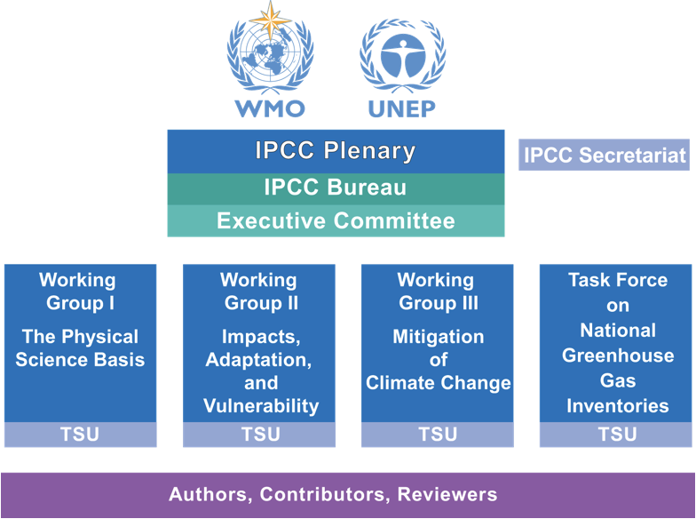
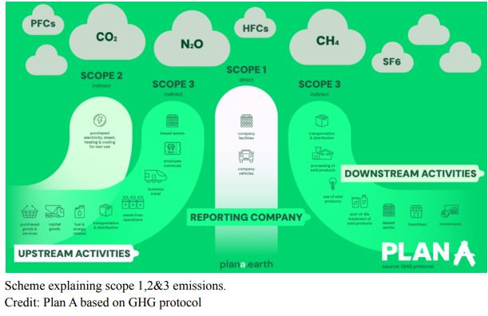
Scopes 1,2 & 3 of emissions

Slide 38
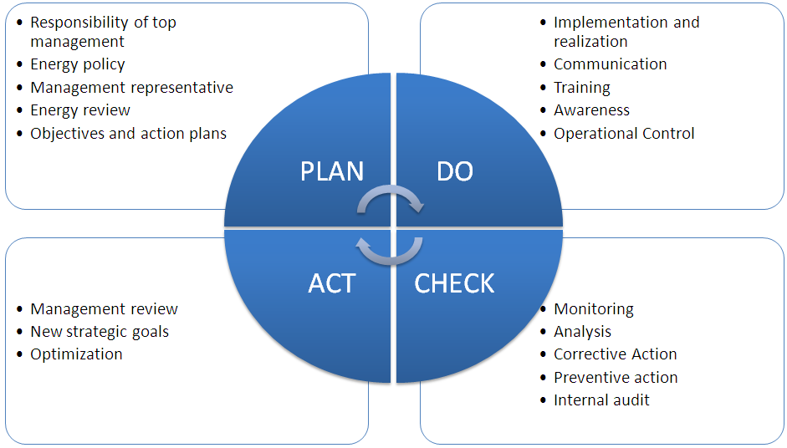
The strategy

Slide 39
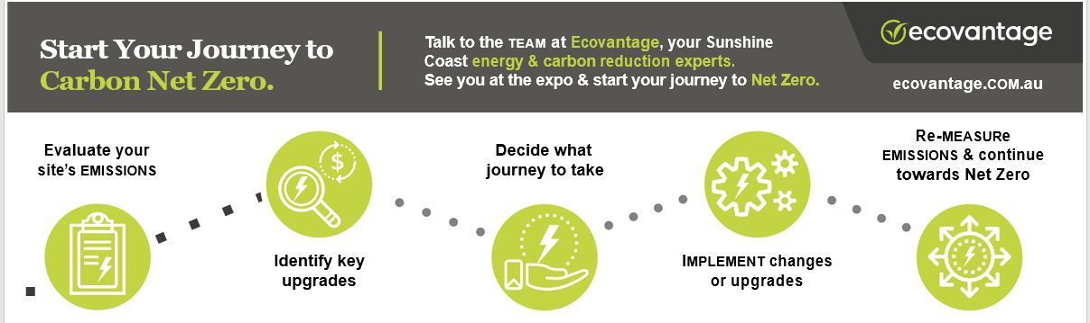
The carbon Journey

Slide 40
Net zero

Slide 41
We encourage you to start a conversation
Words, wisdom, and knowledge should be free.
Let’s Talk

Slide 42
Thank you.
Robert Nap’bleidick
Business Development Manager
0401 112 139

