Slide 1
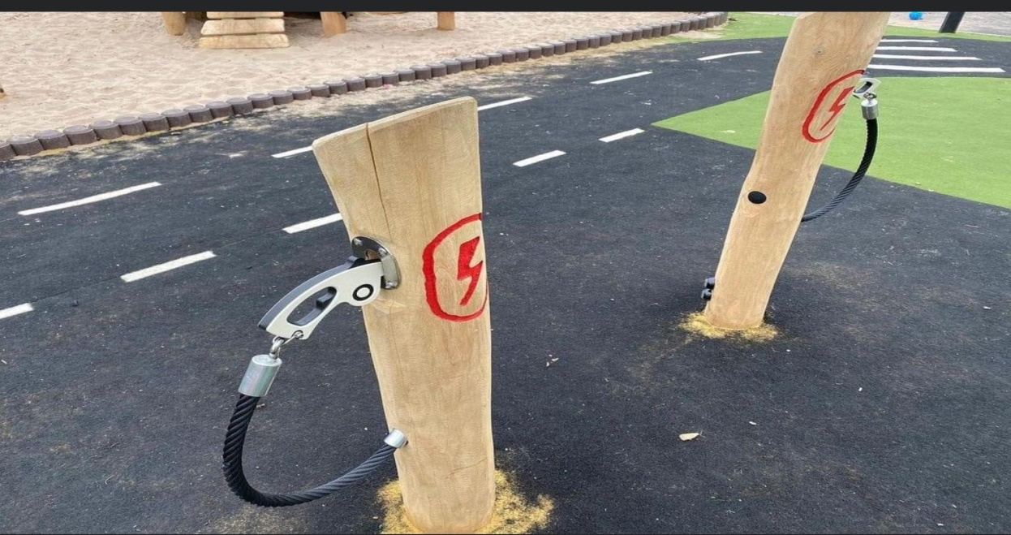
Transport – Possible Futures
Cleantechnica.com
David Waterworth

Slide 2
Days of Future Past

Slide 3
ReThinking Cities
Walking – New York, Holland
Cycling – cash for clunkers vs e bikes (France)
Redesigning the CBD – back to the village
Cities banning FF powered vehicles – see wikipedia

Slide 4
Land Transport
Scooters, Bicycles, Cargo bikes/ trikes
Cars
Small trucks – last mile delivery
Buses
Semi trailers
Trains
Enhance Australia’s energy security – home grown sunshine and wind vs imported oil

Slide 5
Two and Three Wheelers
Scooters
eBikes
Electric motorcycles
Can they replace the second car?
Link to mass transit – eg bus/ train

Slide 6
Electric Passenger Vehicles
Current situation – Global vs Australia
Europe (3 million), China (6) , USA (2)
Barriers to acceptance – availability, cost, power, range, charging. https://www.youtube.com/watch?v=9k7k3Mzknm8&t=789s
Chinese dominance https://insideevs.com/features/496823/sandy-munro-chinese-ev-dominance/

Slide 7
WHY? Cleantechnica.com
Cost savings
Hooning
Regen braking
Low centre of gravity
Last time buying petrol for the car

Slide 8
Trains
Hydrogen
Battery Electric
Gravity powered infinity train

Slide 9
Small Trucks
Cost of last mile delivery – 50%
SEA (Elecrified Hino)
Global – Volvo,Mercedes, Renault, Nissan
Cybertruck, F 150, Rivian, Hummer, Arrival

Slide 10
Buses
Electric buses in Australia
Made in China
Hybrid
Home grown
BYD – China, South America
USA – school buses

Slide 11
Semi Trailers
Tesla Semi
Volvo
Mercedes
Garbage Trucks –
Bucket Truck - https://electrek.co/2021/03/24/con-edison-announces-electric-bucket-truck-with-lion-electric/

Slide 12
Air Transport
Battery Density
Rolls Royce
Inter city passenger jets – Eviation, eVOTL
Commonwealth games
Sea planes (Australia)
https://cleantechnica.com/2021/03/25/groundbreaking-h3x-motor-brings-electric-aircraft-one-step-closer-to-reality/

Slide 13
Sea Travel
Ferries – Norway, USA, Portugal https://cleantechnica.com/2021/04/17/lisbon-orders-10-electric-ferries/
Small freight
https://electrek.co/2021/03/25/tesla-inspired-swedish-x-shore-electric-boat-is-now-coming-to-america/
Sea going hybrids – wind, electric, diesel

Slide 14
FUN
FUVs (Arcimotor) Jetskis, etc https://electrek.co/2021/03/26/brp-commits-to-electrification-of-entire-line-including-jet-skis-go-karts-e-motorcycles/
Electric flying car races - https://thedriven.io/2021/03/26/airspeeder-australian-backed-electric-flying-car-races-coming-soon/

Slide 15
FUD
https://thedriven.io/2021/04/18/jagged-bulldust-why-the-murdoch-media-hates-electric-vehicles-so-much/?fbclid=IwAR1mPfEXNQKx-9oQH0kOTI9-meUlgCiwGO4XWnlcwTT3VKRe7GfIvFdpGeU

Slide 16
Hydrogen
Green, Blue, Grey https://cleantechnica.com/2021/02/24/hydrogen-is-big-oils-last-grand-scam/
Energy density
Why? FF gas, excess renewable energy
Aus – replace FF exports
Cost
Infrastructure – ACT has 20 H2 cars & public fueling
Wastage
https://reneweconomy.com.au/commercial-nonsense-andrew-forrest-explains-why-he-wants-to-dump-fossil-fuels/
https://reneweconomy.com.au/for-hydrogen-to-dominate-the-low-carbon-world-batteries-must-fail/

Slide 17
Cleantechnica.com
End of blue/ grey hydrogen https://cleantechnica.com/2021/04/07/green-hydrogen-to-blue-hydrogen-i-will-drink-your-milkshake/

Slide 18
References
Tony Seba
The future we choose – Figueres & Rivett Carnac
Insideevs.com
Cleantechnica.com
Electrek.com
Reneweconomy.com.au
Teslarati.com

